Slide 1
Transformations
Angel: Interactive Computer Graphics 5E © Addison-Wesley 2009

Slide 2
Objectives
Introduce affine transformations
  Translation
  Rotation
  Scaling
Derive homogeneous coordinate transformation matrices
Learn to build arbitrary transformation matrices from simple transformations
Angel: Interactive Computer Graphics 5E © Addison-Wesley 2009

Slide 3
General Transformations
A transformation maps points to other points and/or vectors to other vectors
    (x,y,z) -> (x’,y’,z’)
Affine transformations such as translation, rotation and scaling are line preserving
These rigid body transformations are used widely in computer graphics
Angel: Interactive Computer Graphics 5E © Addison-Wesley 2009

Slide 4
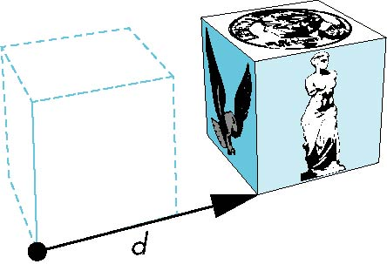

Translation
Translate the (x,y,z) coordinates of all points on an object to by displacement d
object
Angel: Interactive Computer Graphics 5E © Addison-Wesley 2009

Slide 5
Translation
Translate a point P=(x,y,z) to a new location P’=(x’,y’,z’)
Displacement given by vector d=(dx,dy,dz)
Hence P’=(x’,y’,z’) = (x+dx, y+dy, z+dz)
P’
d
P
Angel: Interactive Computer Graphics 5E © Addison-Wesley 2009

Slide 6
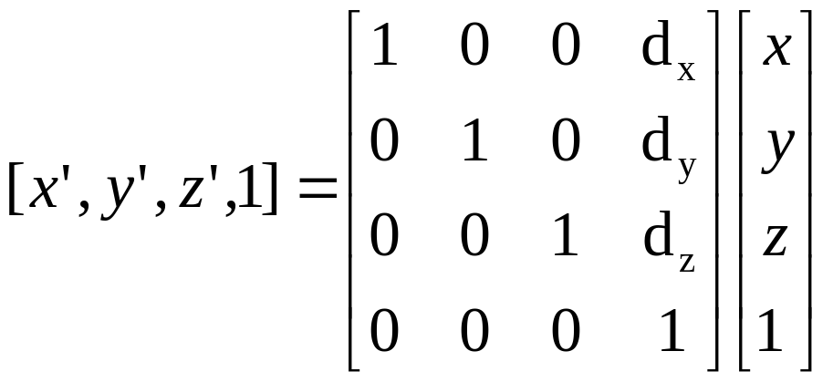
Translation
Translation can be expressed in terms of a matrix multiplication by representing 3D points (x,y,z) in Homogeneous coordinates (x,y,z,1)
Angel: Interactive Computer Graphics 5E © Addison-Wesley 2009

Slide 7
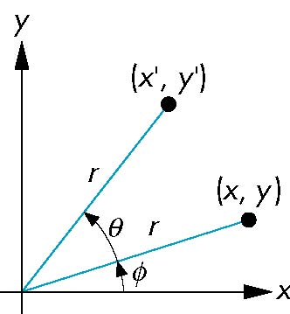
Rotation in 2D
Consider rotation of point (x,y) about the origin by θ degrees in polar coordinates:
x = r cos φ
y = r sin φ
x’ = r cos (φ + θ)
r cos φ cos θ – r sin φ sin θ
x cos θ – y sin θ
y’ = r sin (φ + θ)
= r sin φ cos θ + r cos φ sin θ
= x sin θ + y cos θ
Angel: Interactive Computer Graphics 5E © Addison-Wesley 2009

Slide 8
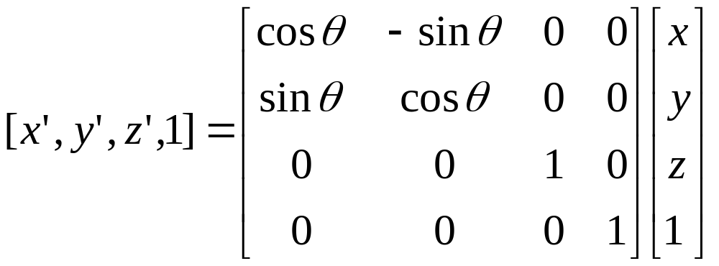
Rotation about z axis
Rotation about z axis in 3D leaves all points with the same z coordinate
x’ = x cos θ – y sin θ
    y’ = x sin θ + y cos θ
    z’ = z
Angel: Interactive Computer Graphics 5E © Addison-Wesley 2009

Slide 9
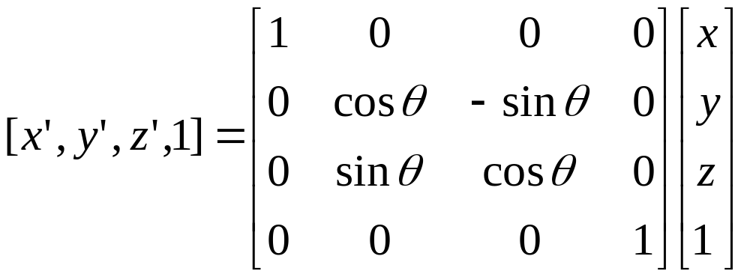
Rotation about x axis
Same argument as for rotation about z axis
  For rotation about x axis, x is unchanged
    x’ = x
    y’ = y cos θ – z sin θ
    z’ = y sin θ + z cos θ
Angel: Interactive Computer Graphics 5E © Addison-Wesley 2009

Slide 10
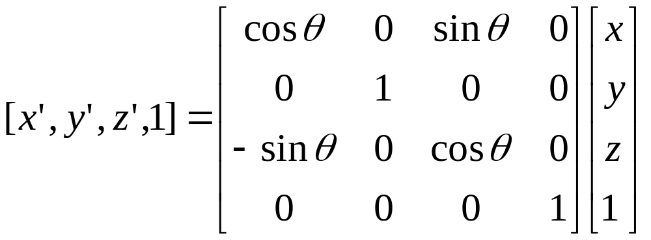
Rotation about y axes
Same argument as for rotation about z axis
  For rotation about y axis, y is unchanged
    x’ = x cos θ + z sin θ
    y’ = y
    z’ = - x sin θ + z cos θ
Angel: Interactive Computer Graphics 5E © Addison-Wesley 2009

Slide 11
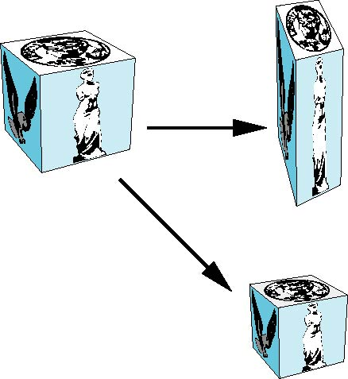
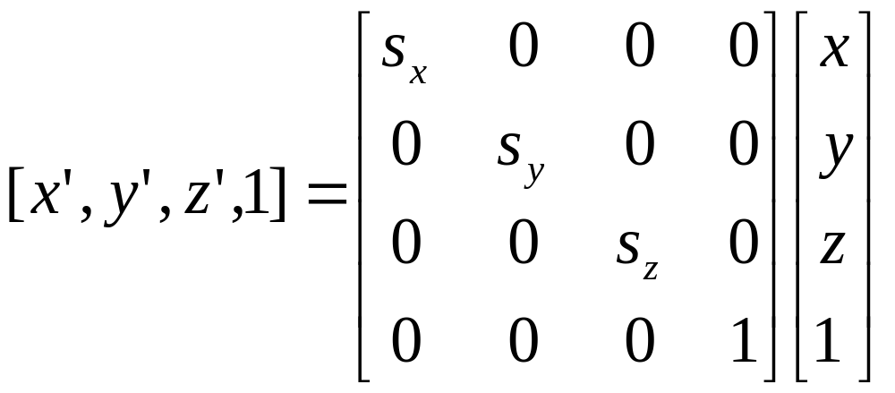
Scaling
Expand or contract object along each axis
x’=s_{x} x
y’=s_{y} y
z’=s_{z} z
Angel: Interactive Computer Graphics 5E © Addison-Wesley 2009

Slide 12
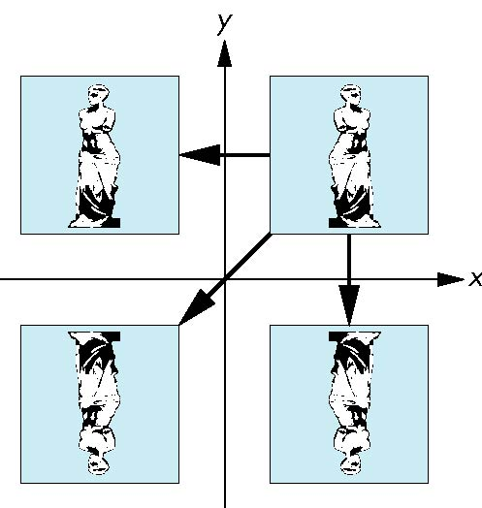
Reflection
corresponds to negative scale factors
s_{x} = -1 s_{y} = 1
original
s_{x} = -1 s_{y} = -1
s_{x} = 1 s_{y} = -1
Angel: Interactive Computer Graphics 5E © Addison-Wesley 2009

Slide 13
Inverses
Although we could compute inverse matrices by general formulas, we can use simple geometric observations
  Translation: T⁻¹(d_{x}, d_{y}, d_{z}) = T(-d_{x}, -d_{y}, -d_{z})
  Rotation: R⁻¹(θ) = R(-θ) = R^{T}(θ)
    Holds for any rotation matrix because
    cos(-θ) = cos(θ) and sin(-θ)= -sin(θ)
  Scaling: S⁻¹(s_{x}, s_{y}, s_{z}) = S(1/s_{x}, 1/s_{y}, 1/s_{z})
Angel: Interactive Computer Graphics 5E © Addison-Wesley 2009

Slide 14
Concatenation
We can form arbitrary affine transformation matrices by multiplying together rotation, translation, and scaling matrices
Because the same transformation is applied to many vertices, the cost of forming a matrix M=ABCD is not significant compared to the cost of computing Mp for many vertices p
The difficult part is how to form a desired transformation from the specifications in the application
Angel: Interactive Computer Graphics 5E © Addison-Wesley 2009

Slide 15
Order of Transformations
Consider the composite transformation matrix M=ABC
When we calculate Mp, matrix C is the first applied, then B, then A
Mathematically, the following are equivalent
p’ = ABCp = A(B(Cp))
Hence composition order really matters!!
Angel: Interactive Computer Graphics 5E © Addison-Wesley 2009

Slide 16
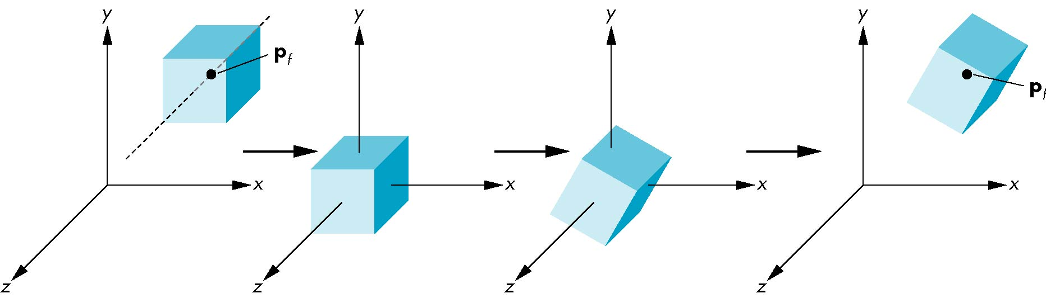
Rotation About Point P
Move fixed point P to origin
Rotate by desired angle
Move fixed point P back
M = T(p_{f}) R(θ) T(-p_{f})
Angel: Interactive Computer Graphics 5E © Addison-Wesley 2009

